Slide 1
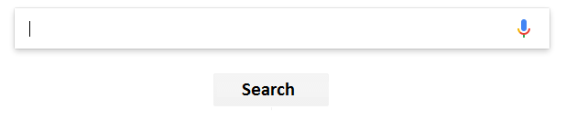
Search Engine: Stevens Computer Courses
Team: Abhilash ugaonkar, Viraj Gite professor: Wendy Wang

Slide 2
Agenda
Introduction
Motivation
System Framework
Web Crawler an Corpus
Boolean Retrieval Model
Vector Space Model
Model Evaluation
Progress
Progress Viraj Gite
Progress Abhilash Ugaonkar
Conclusion

Slide 3
INTRODUCTION

Slide 4
Motivation
Enable Stevens community to retrieve course details
Reduce the use effort by retrieving set of document which satisfy information need
1
Understand behind the scene functionality and complexity of search engines Compare Boolean and Vector Space retrieval models
2

Slide 5
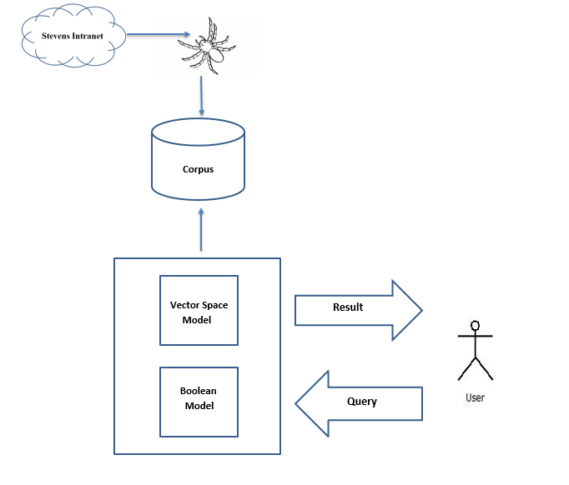
Framework

Slide 6
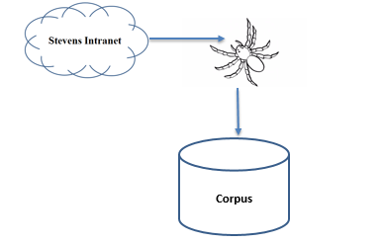
Corpus and Web Crawler
Function
Corpus
Contains the all the syllabus documents fetched by the crawler
Web Crawler
Input :
Accepts the file with web address of the syllabus files
Syllabus files on the web are in XML format
Ex: https://web.stevens.edu/csfiles/graduate/masters/courses/CS501syl.xml
Output:
Downloads the files from specifies location
Convert the XML syllabus file to simple txt format

Slide 7
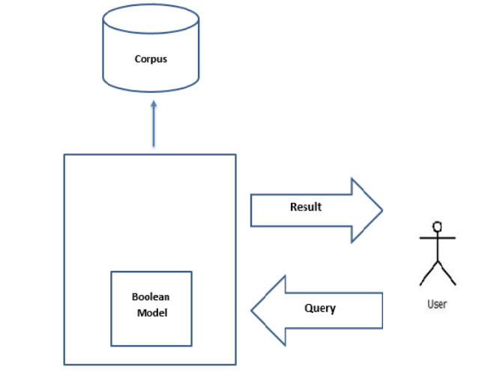
Boolean Retrieval Model
Weight are assigned to terms: “0” or “1”
“0” represents “absence”: term is not in the document
“1” represents “presence”: term is in the document
Build queries by combining terms with Boolean operators
AND, OR, NOT
Model returns all documents which satisfies the query

Slide 8
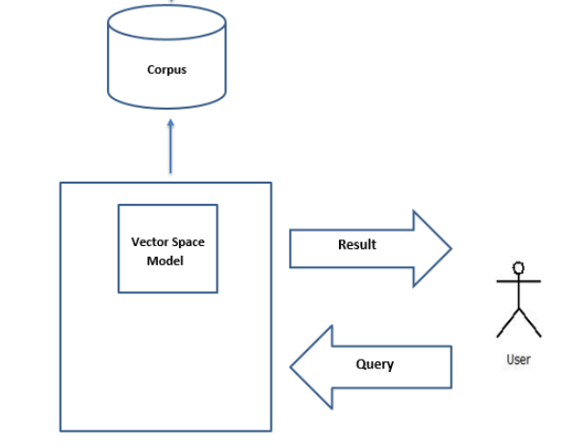
Vector Space Retrieval Model
Input: t distinct terms we call them index terms
For every term i, and for its occurrence in a document/query j, it is assigned a real-valued weight Wij.
Convert all documents in collection D to tf-idf weighted vectors, dj, for keyword vocabulary V.
Convert query to a tf-idf-weighted vector q.
For each dj in D do
Compute score sj = cosSim(dj, q)
Sort documents by decreasing score.
Present top ranked documents to the user

Slide 9
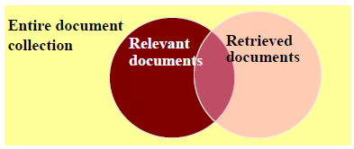
Evaluation of Model
Precision and Recall
Precision P = tp/(tp + fp)
Recall R = tp/(tp + fn)
Evaluation of the model is carried out by calculating Precision and Recall

Slide 10
PROGRESS

Slide 11
PROGRESS : Abhilash
Sr | Functions | Done
1 | def initialize_terms_and_postings()
2 | def similarity(query,id)
3 | def pre_rec(query,result_doc_id)
4 | Syllabus downloader module ()
All tasks are completed there are no pending tasks for Abhilash

Slide 12
PROGRESS : Viraj
Sr | Functions | Done
1 | def query_handler()
2 | def pre_rec()
3 | Syllabus downloader module ()
All tasks are completed there are no pending tasks for Viraj

Slide 13
Conclusion
Boolean Model
Vector Space Model
Easy to implement
Rigid
Fetches the information based on the binary logic without partial matches
Doesn’t adequately reflect users intention
Complex to build but not rigid as Boolean model
Provides partial Matching and ranked results
Suitable for large document collection
Lacks the control of Boolean Model

Slide 14
THANK YOU!

Slide 15
QUESTIONS?

